Slide 1
ZA-2022-760-ZAA
1150 N La Collina Dr.
Zoning Administrator's Adjustment for construction of gate in required front yard setback exceeding 8 feet in height pursuant to 12.28 as required by 12.21.C1.g.

Slide 2
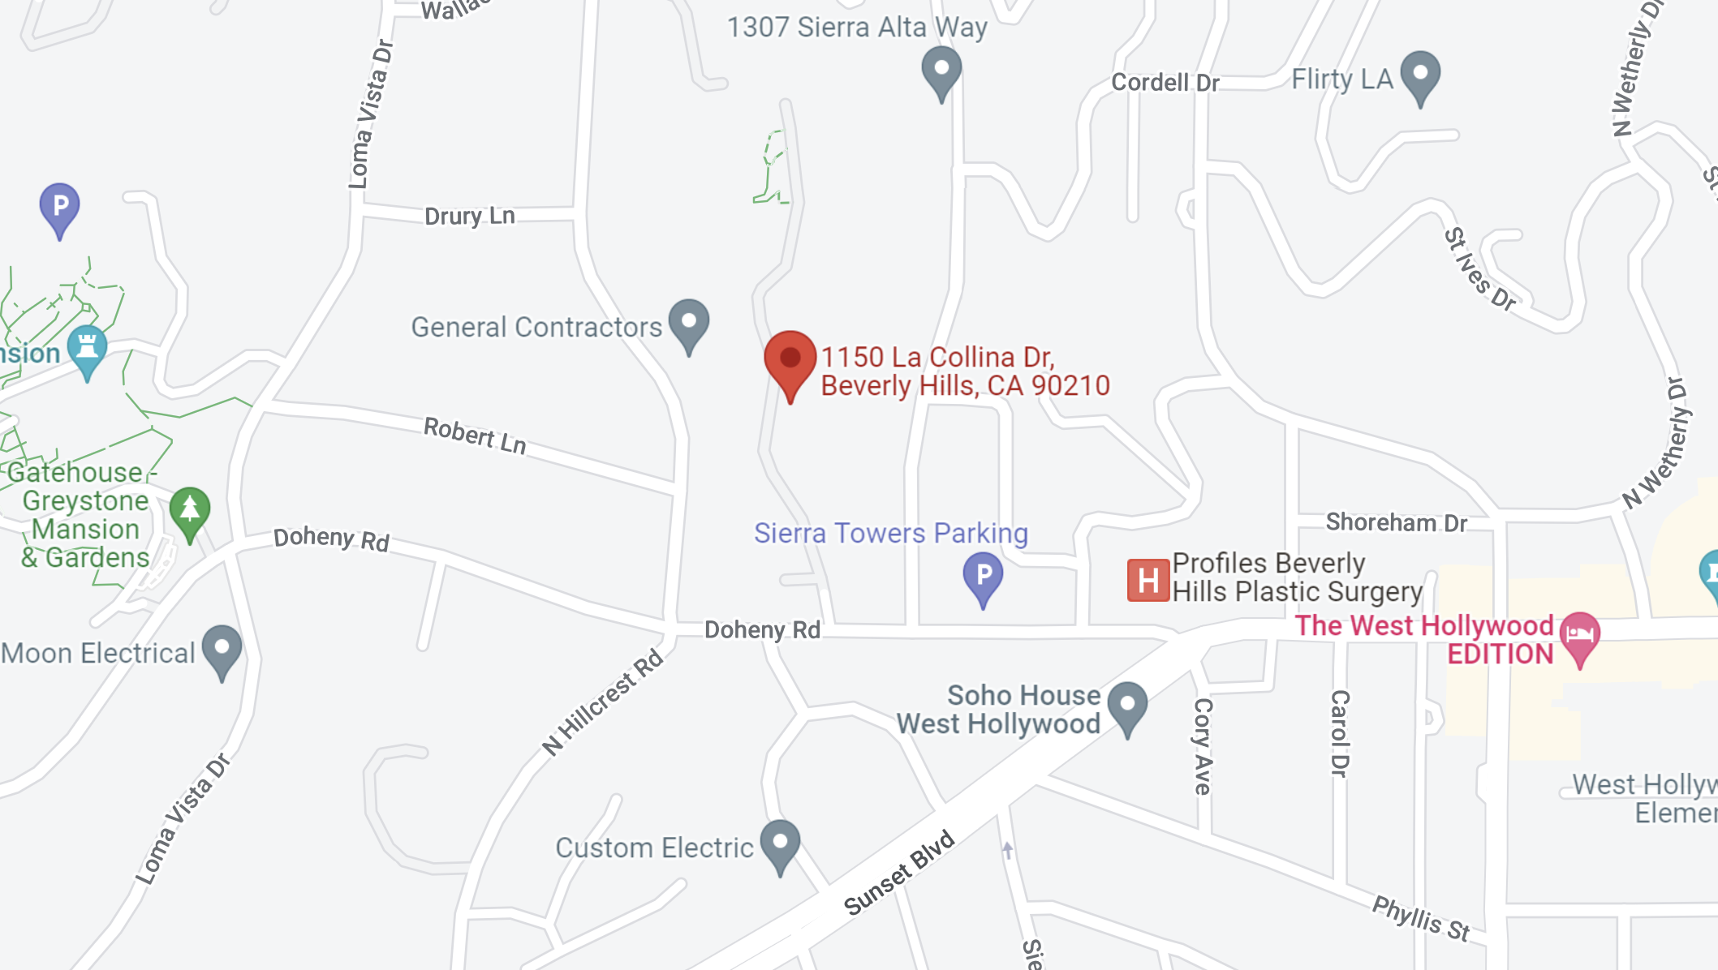
Location

Slide 3
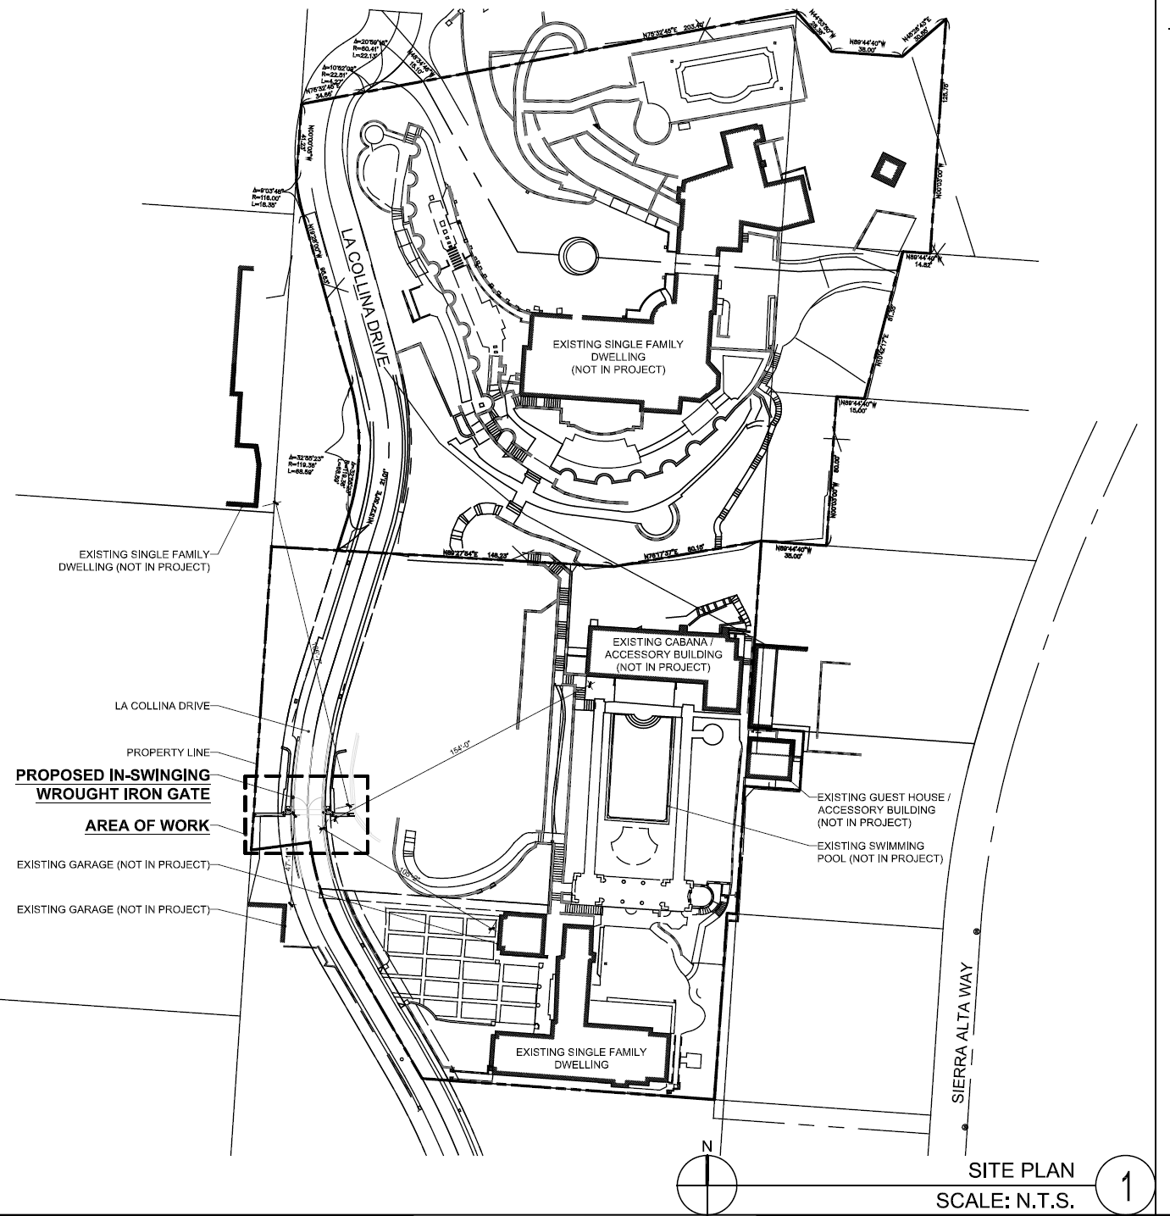
Site Plan

Slide 4
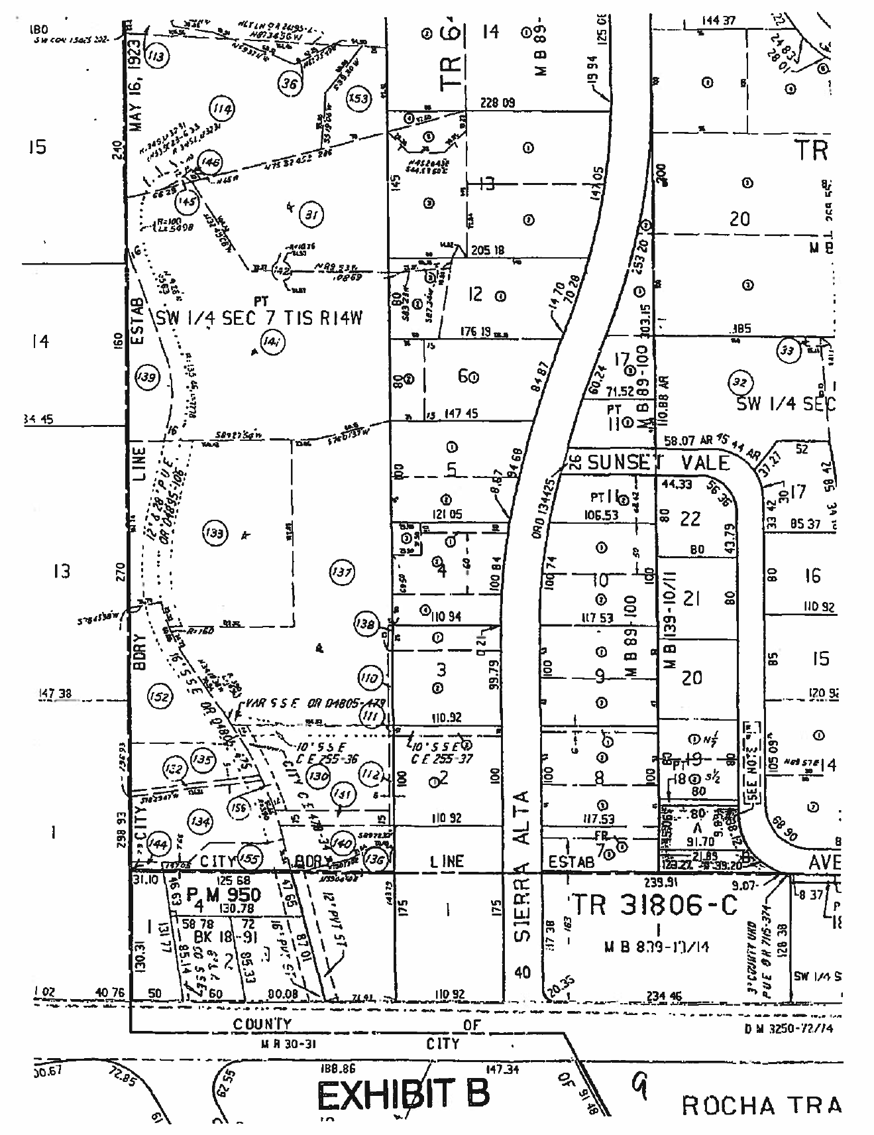
Private Street
AA-2008-3670-DPS Exhibit B

Slide 5
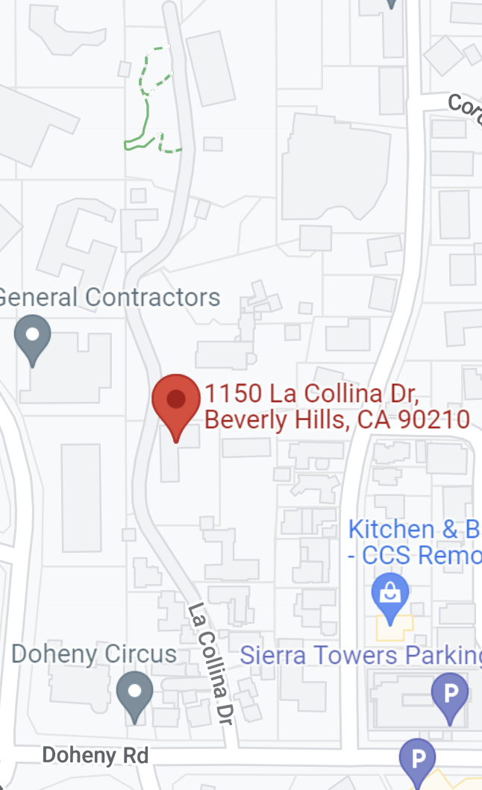
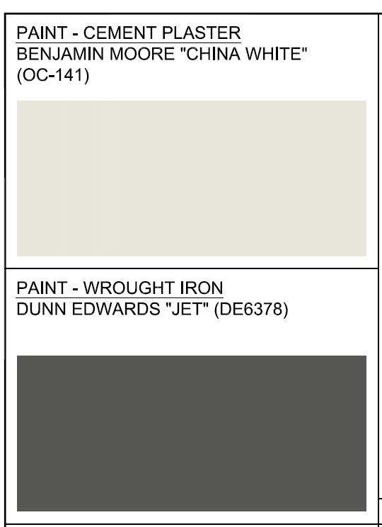
Proposed Gate/Fence Design
(N) Gate

Slide 6
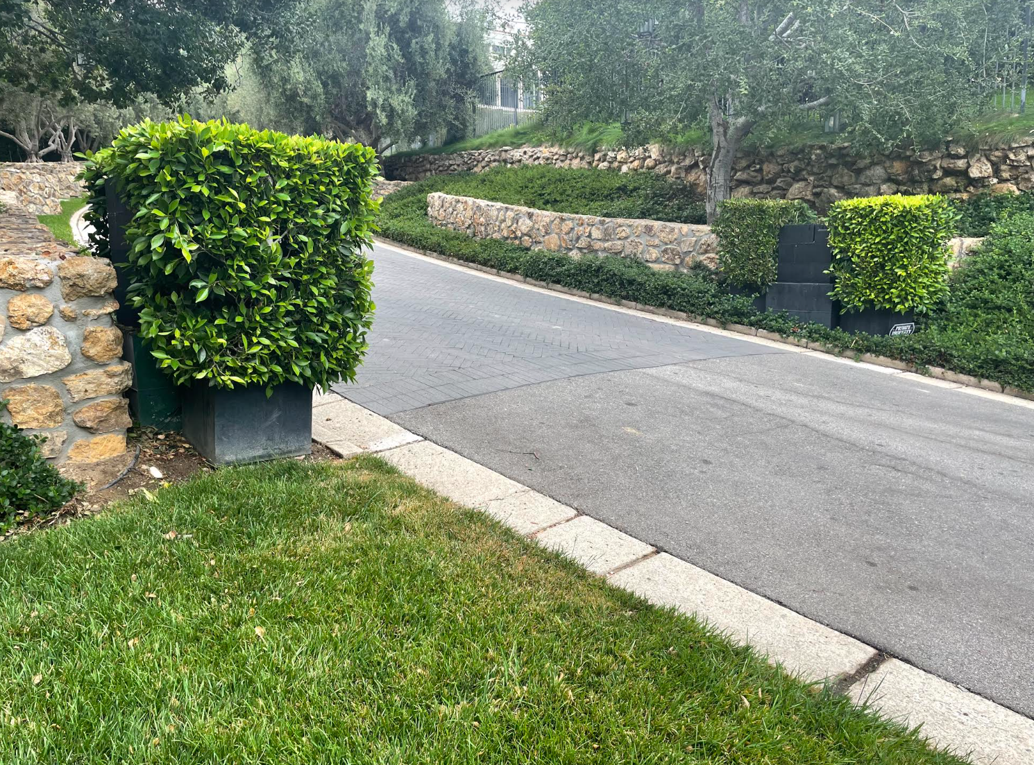
Existing Conditions
(E) Stub Ups

Slide 7
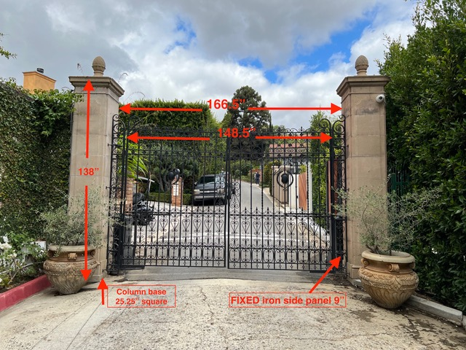
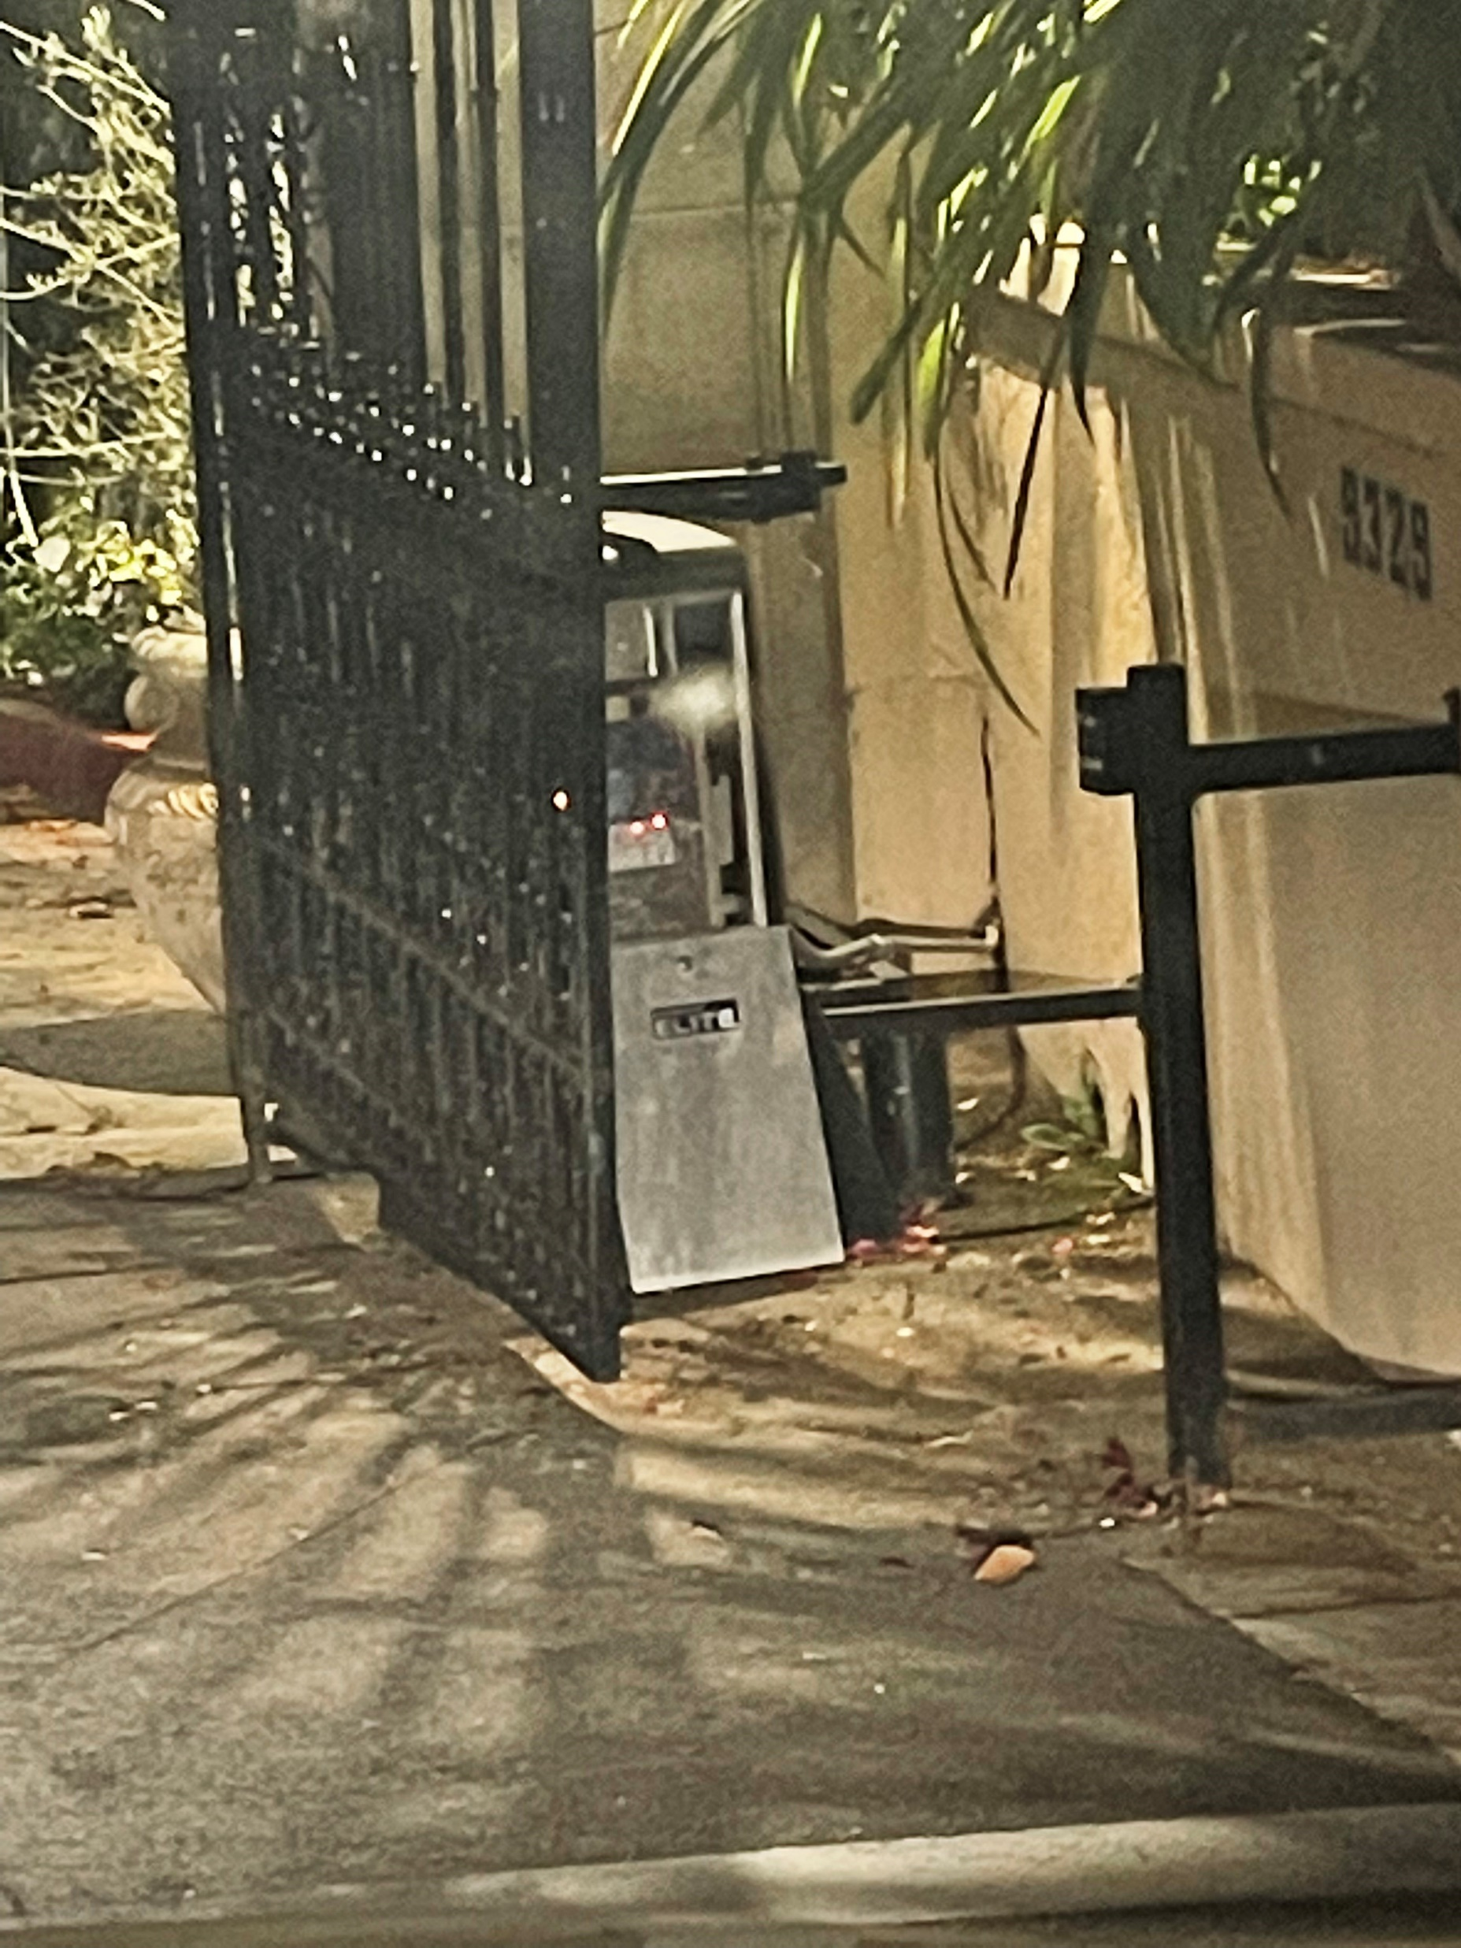
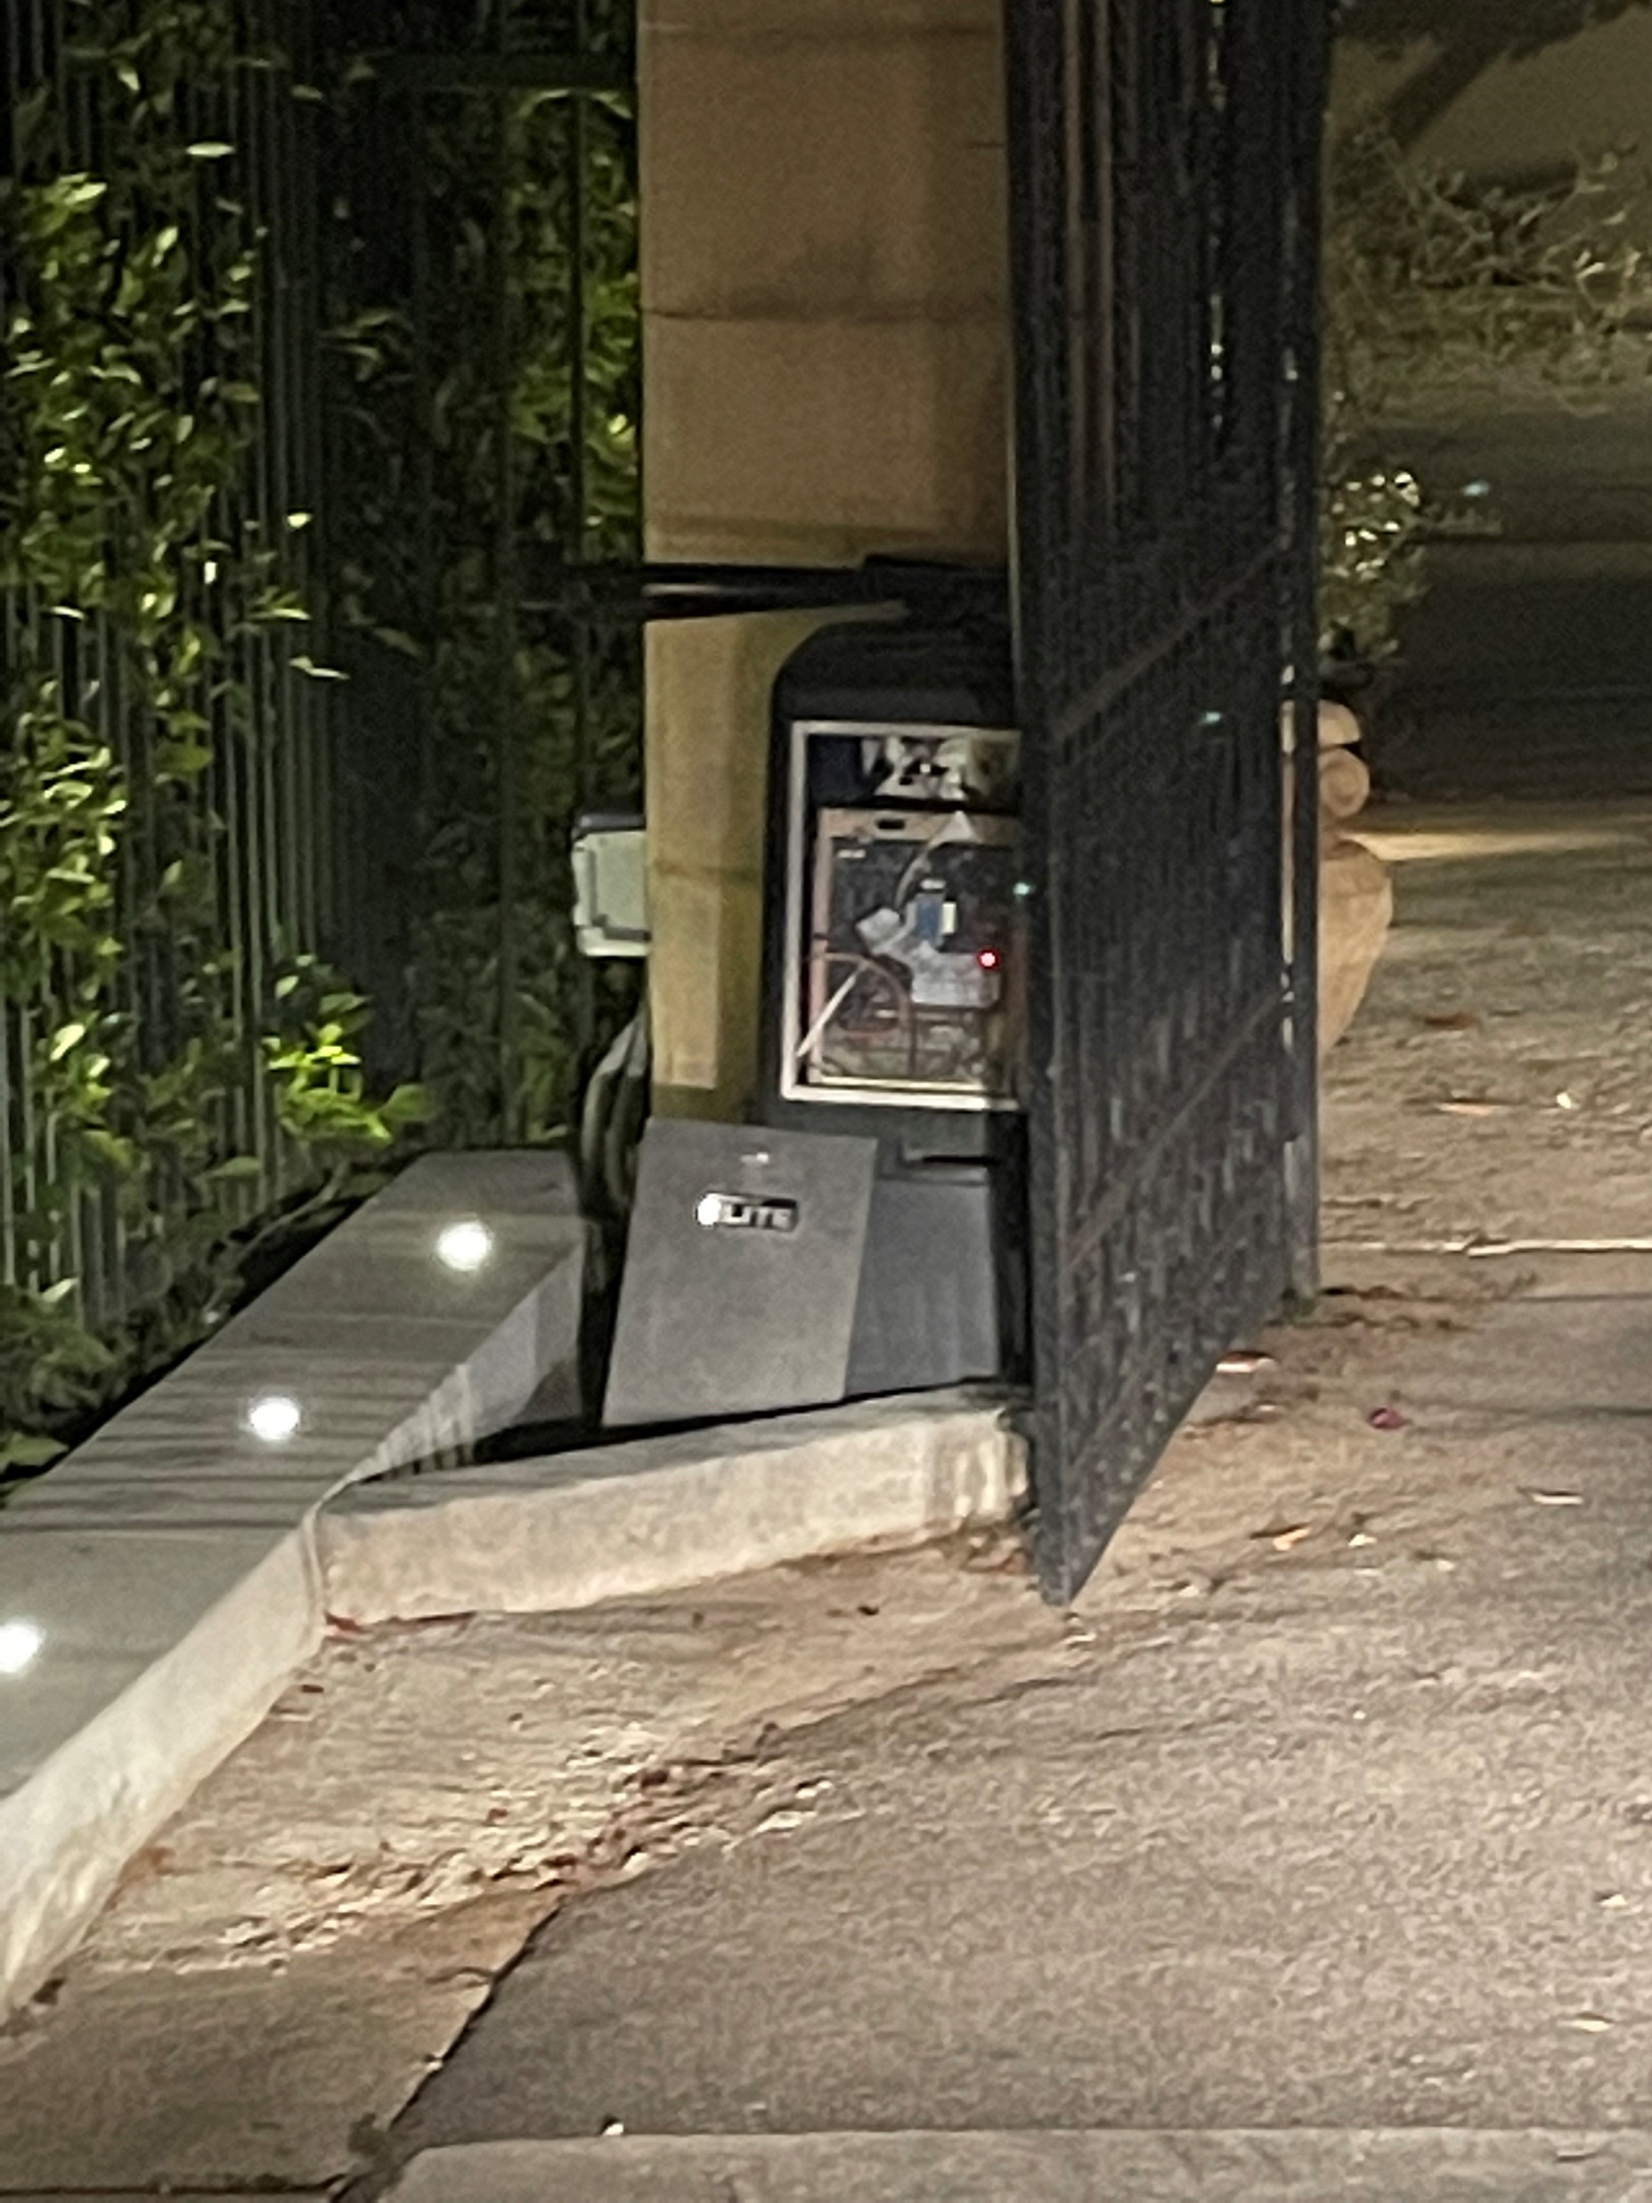
Existing Gate at La Collina & Doheny
Damaged Mechanical Boxes,
June 2022
(E) Gate #1

Slide 8
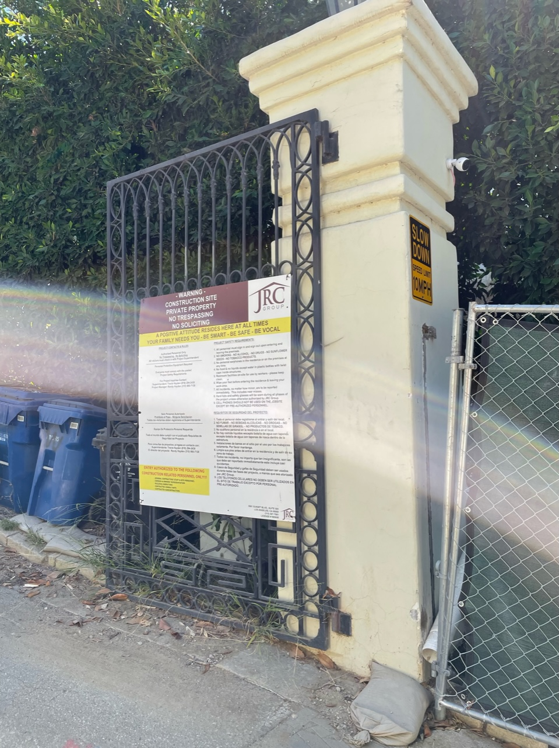
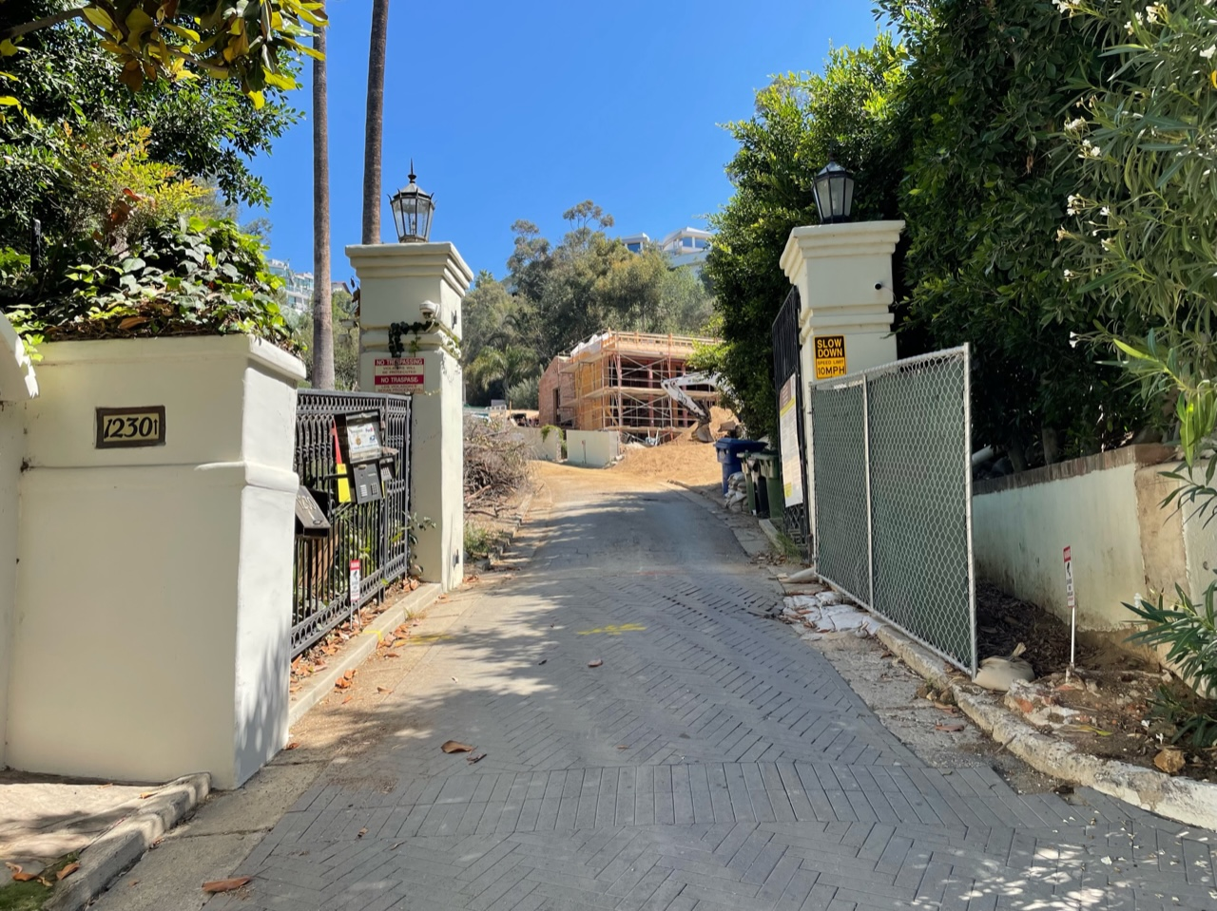
Existing Gate to the North Crossing La Collina
(E) Gate #2

Slide 9
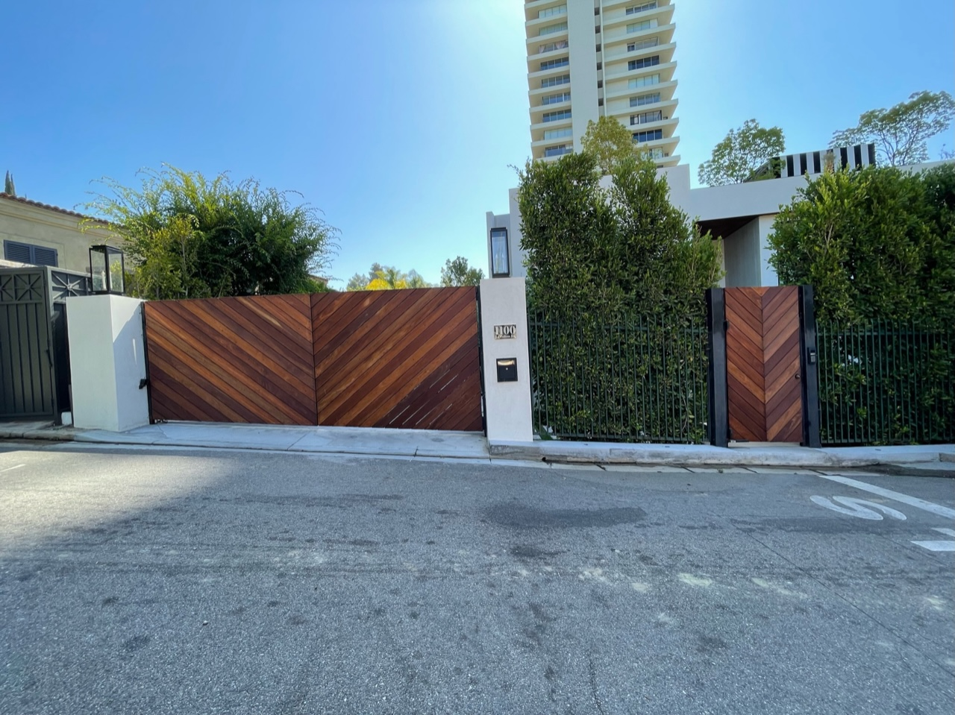
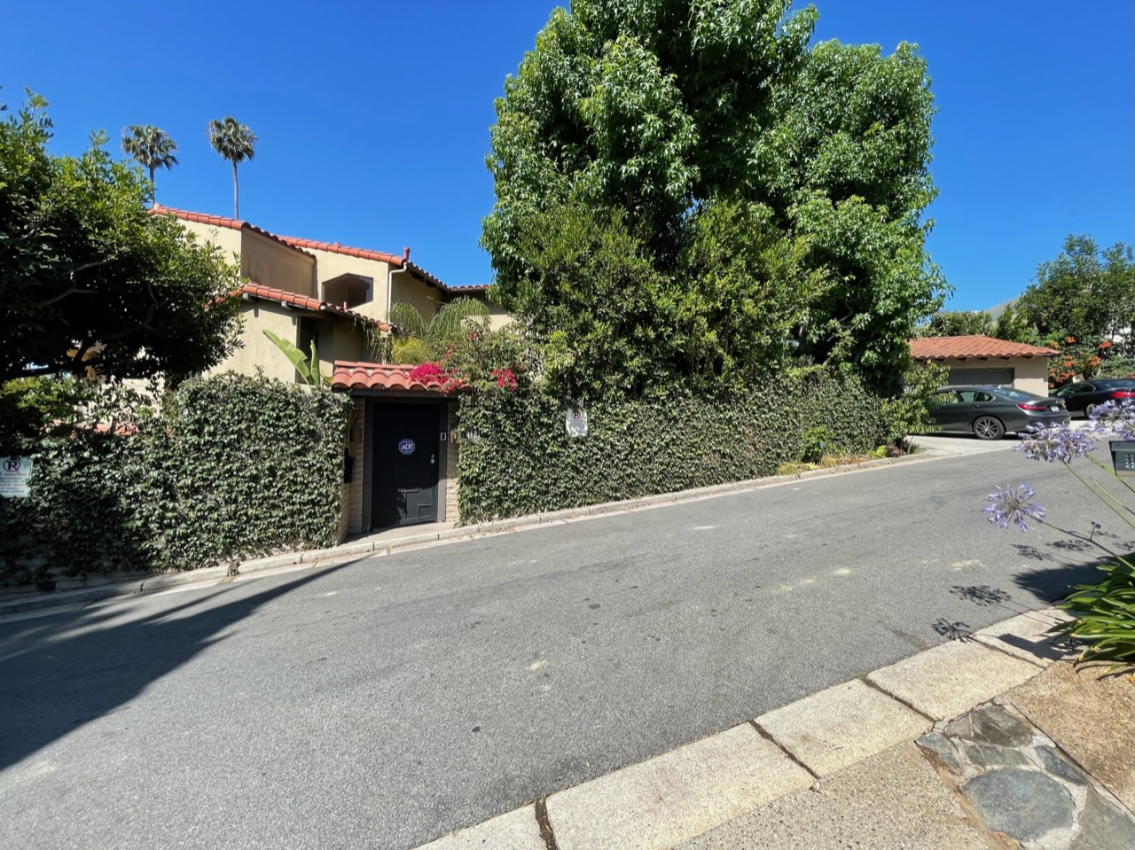
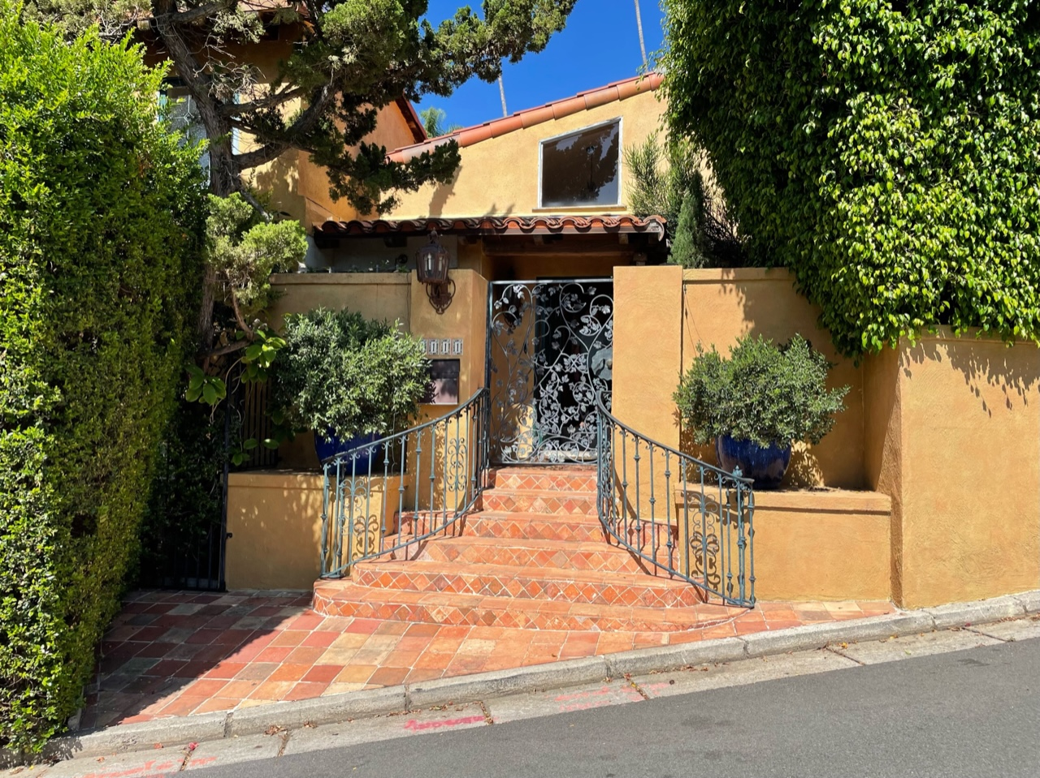
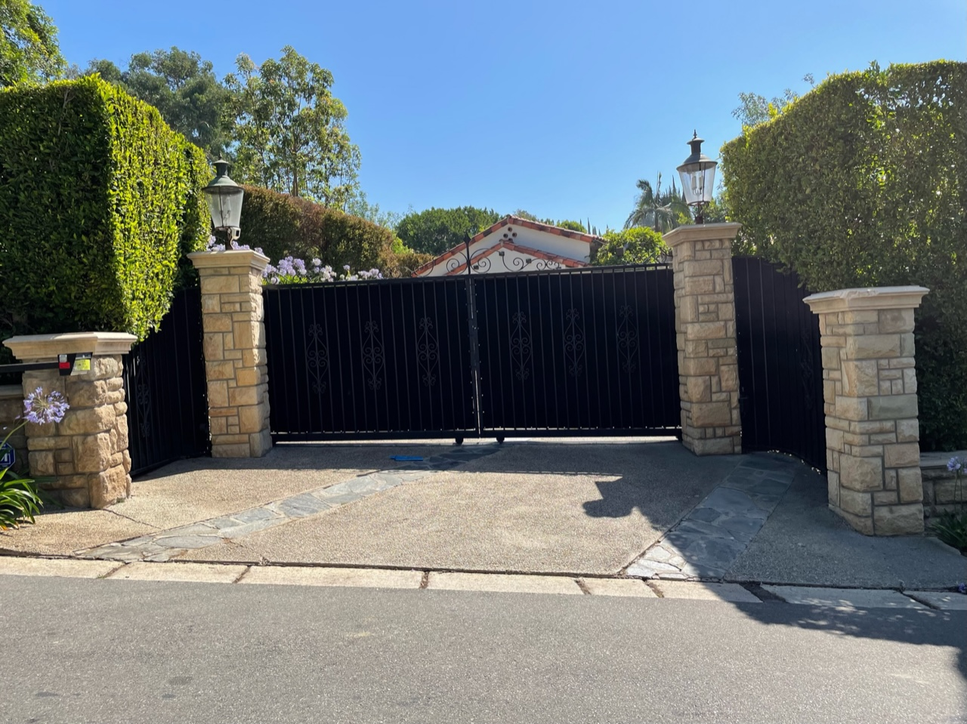
Surrounding Fences/Gates
1
3
(N) Gate
2
4
4
3
1
2

Slide 10
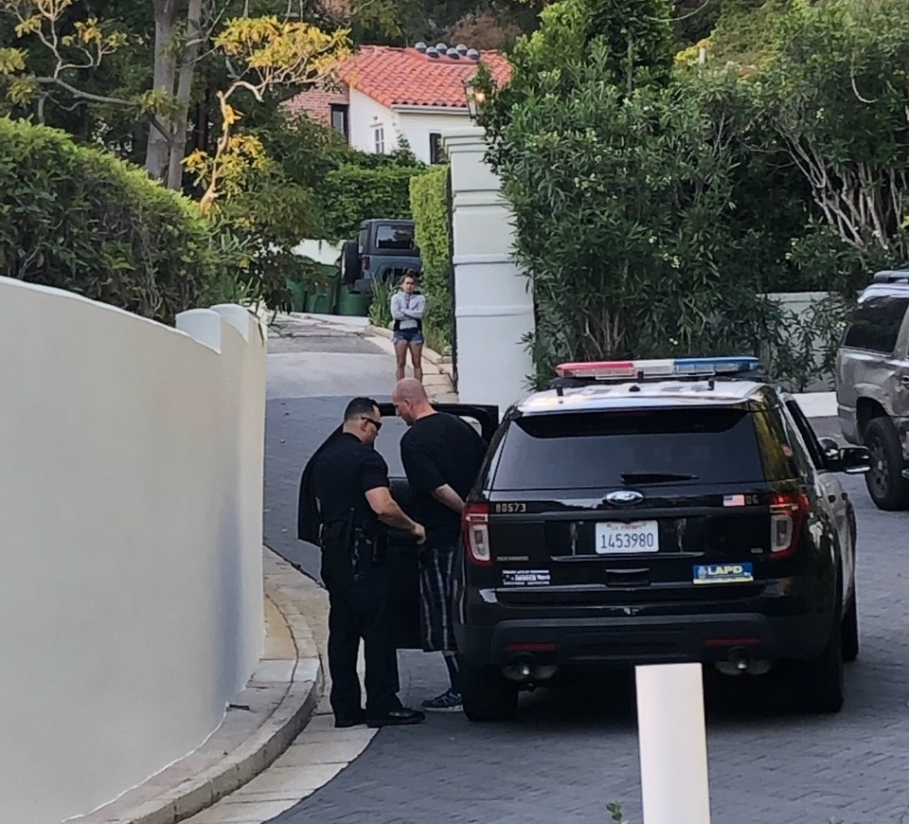
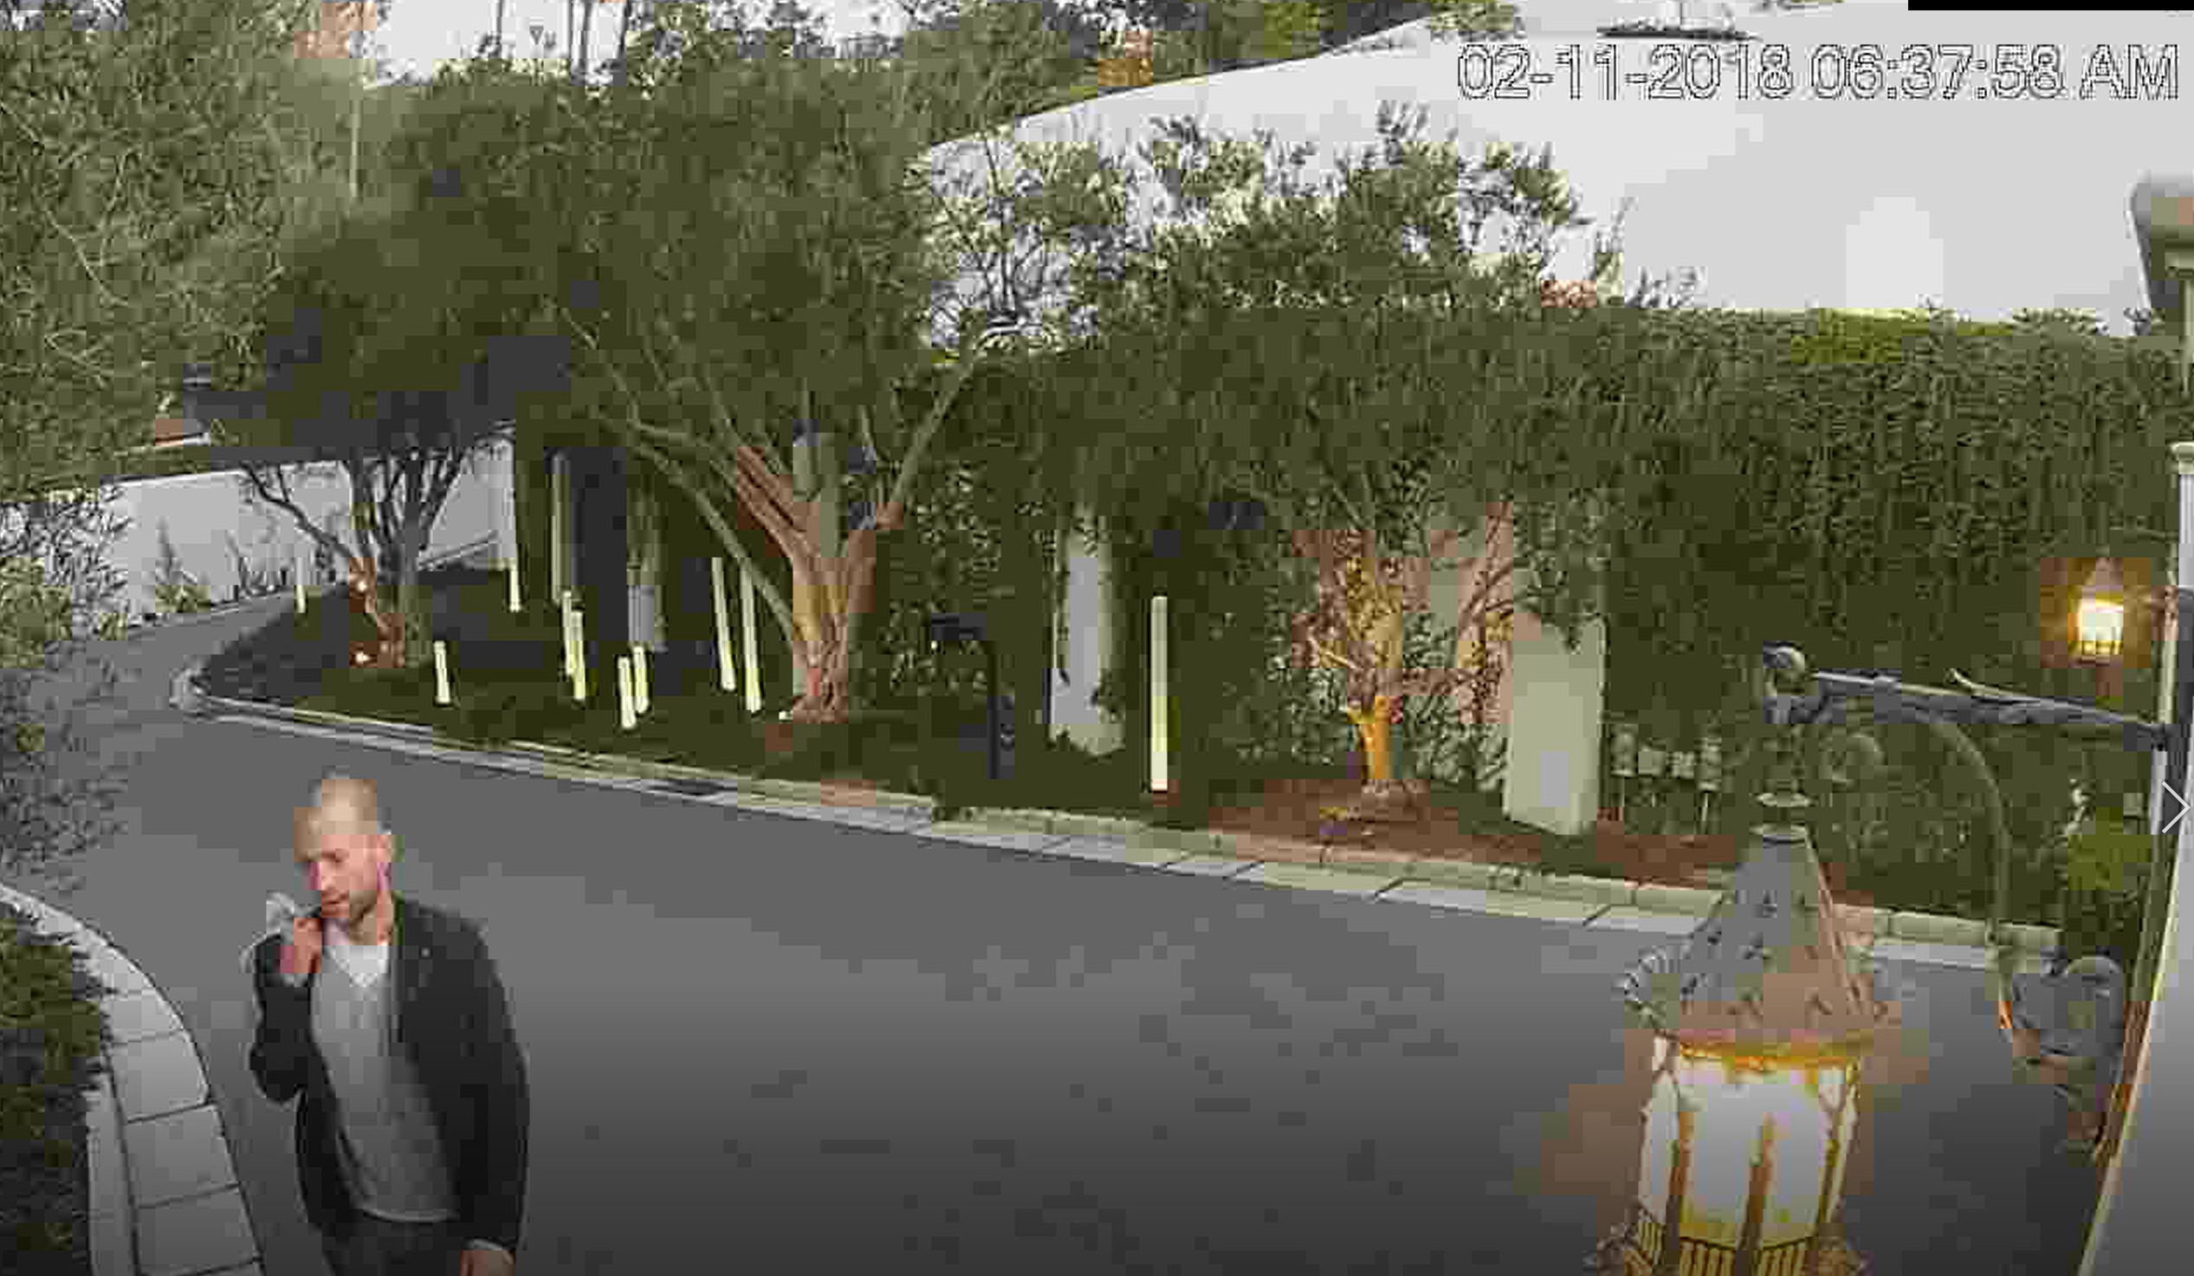
Security Concerns
Multiple Incidents of Trespassing on the Property
Burglary, Crime, and Murder on the Surrounding Properties
LAFD Precinct Location
Short-Term Rentals

Slide 11
Conclusion
Additional Security
Improvement of Existing Gate Conditions
Stylistically Compatible Design
Neighbor Supported

