Slide 1
2424 BRIARCREST
HEUSCH ARCHITECTURE

Slide 2
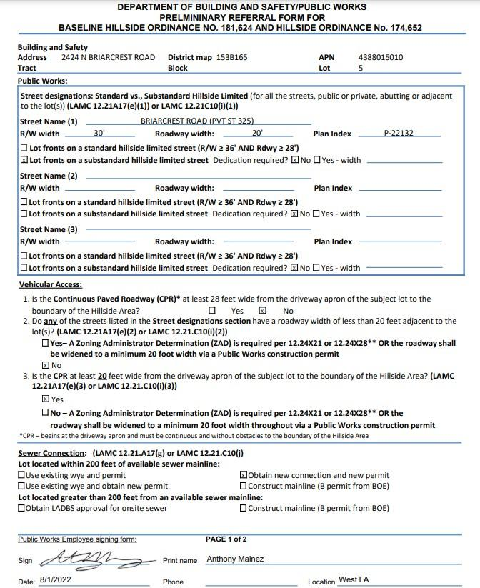
WIDTH OF STREET

Slide 3
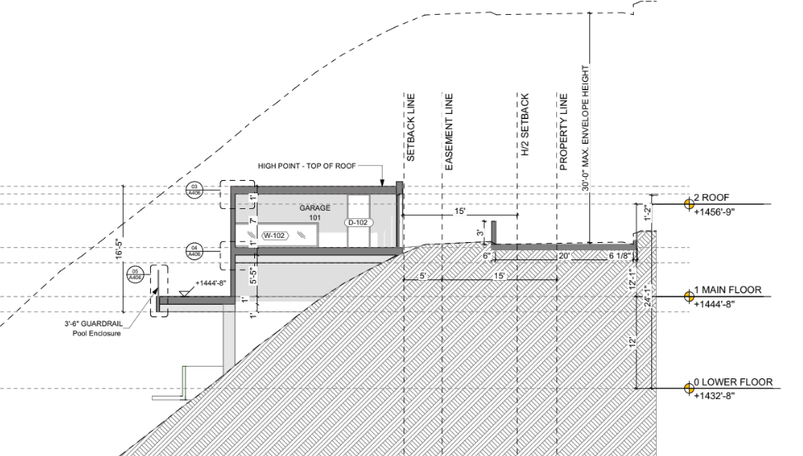
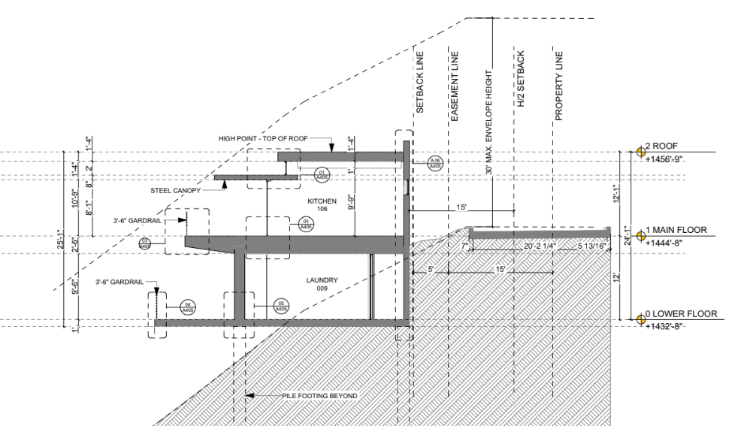
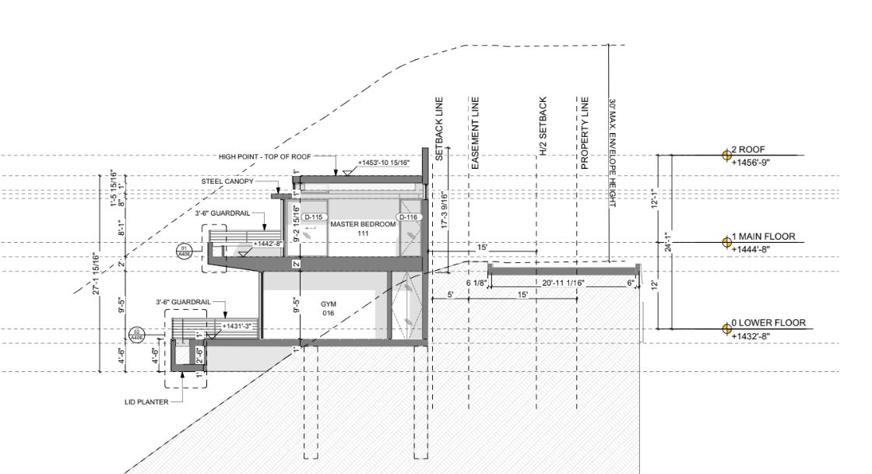
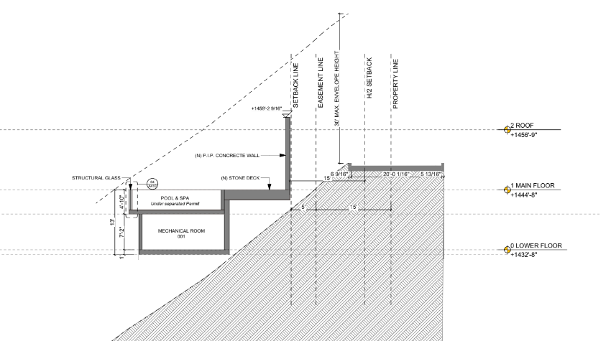
WIDTH OF STREET

Slide 4
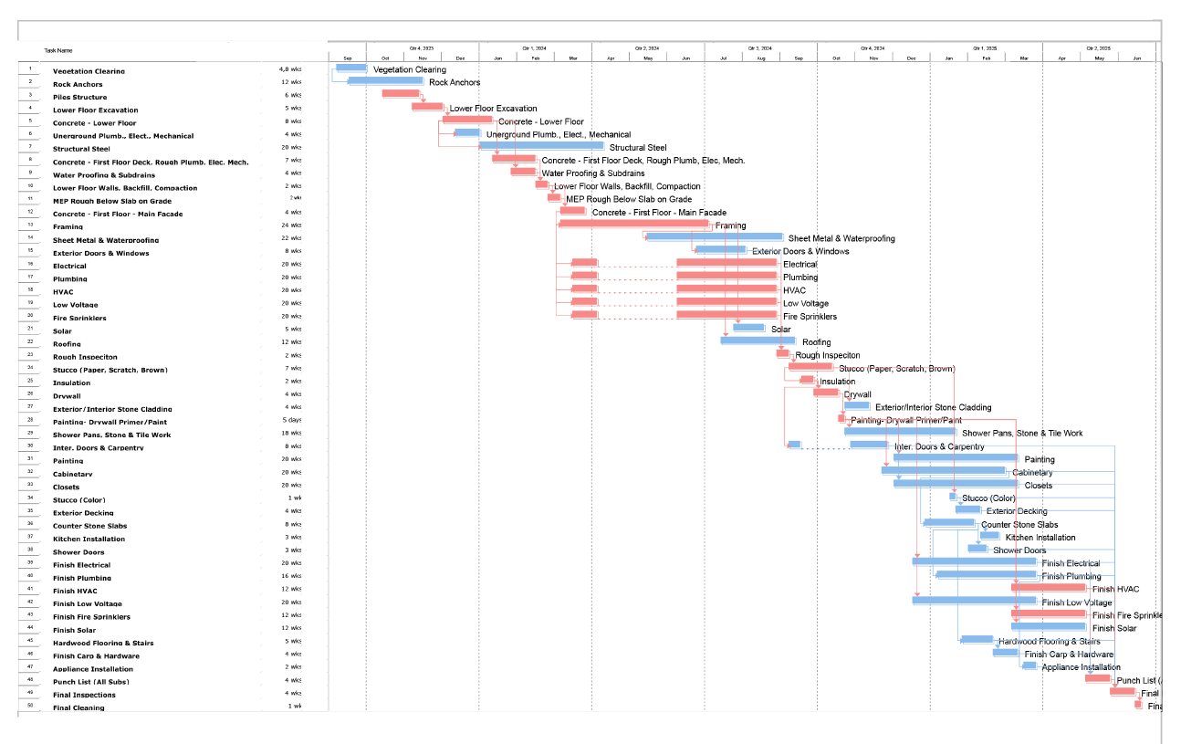
CONSTRUCTION PHASING

Slide 5
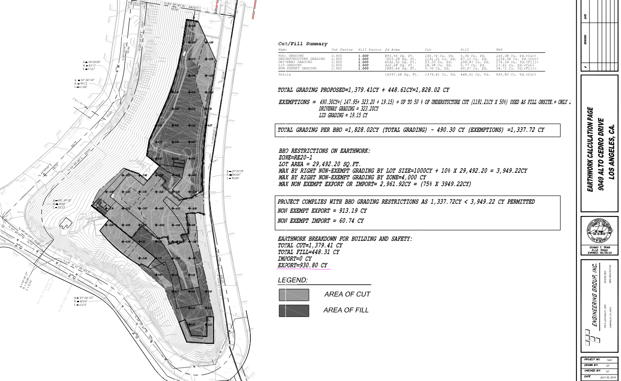

Slide 6
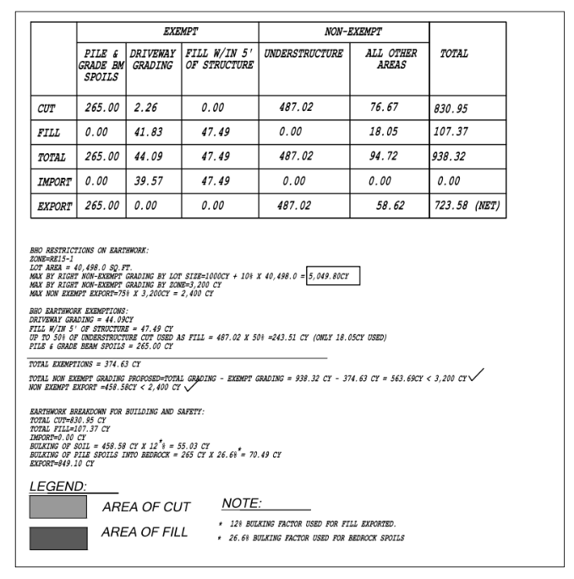
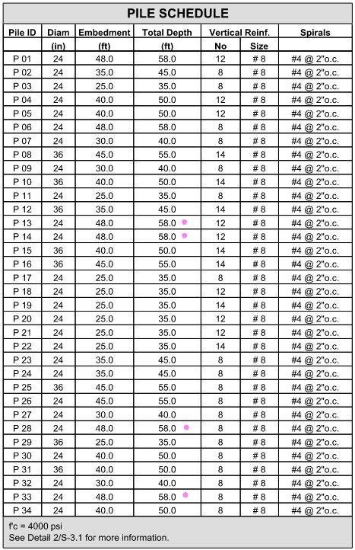
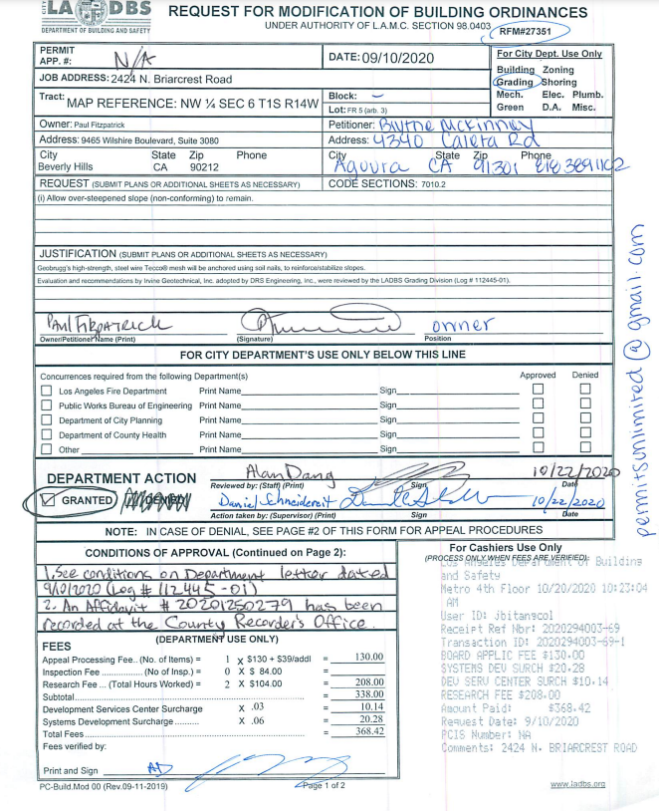
GRADING CALCULATIONS

Slide 7
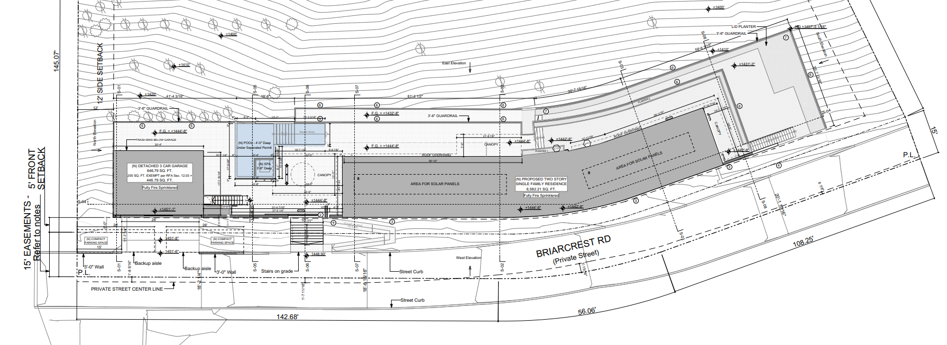
PARKING SPACES

Slide 8
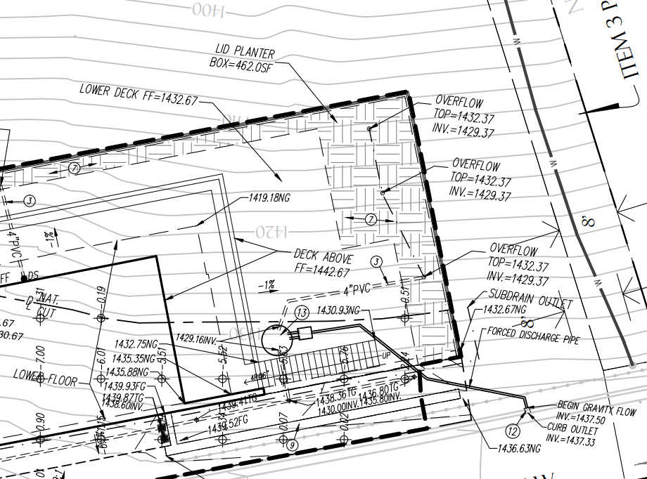
LID PLANTER

Slide 9
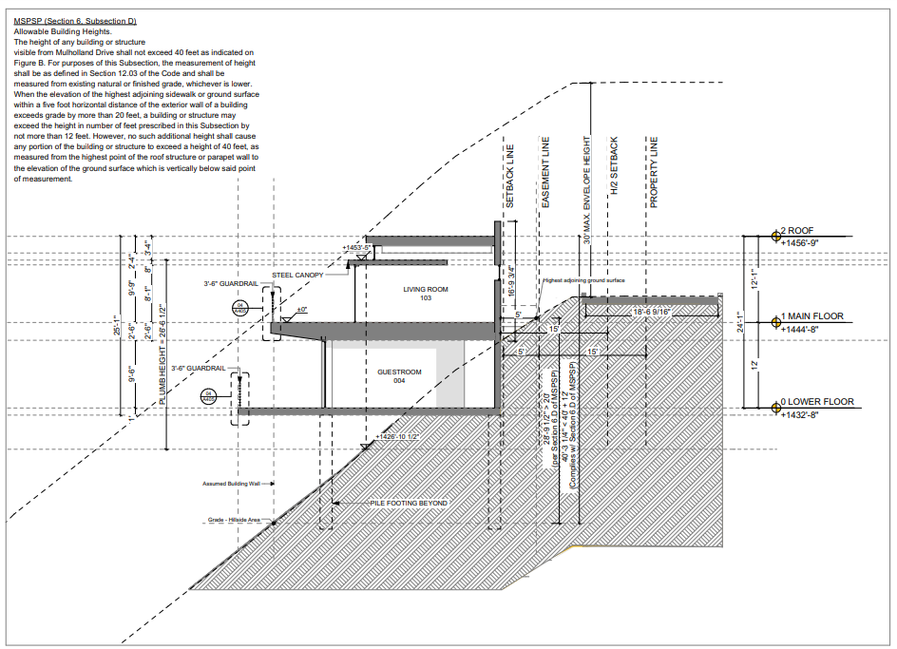
BUILDING HEIGHT

Slide 10
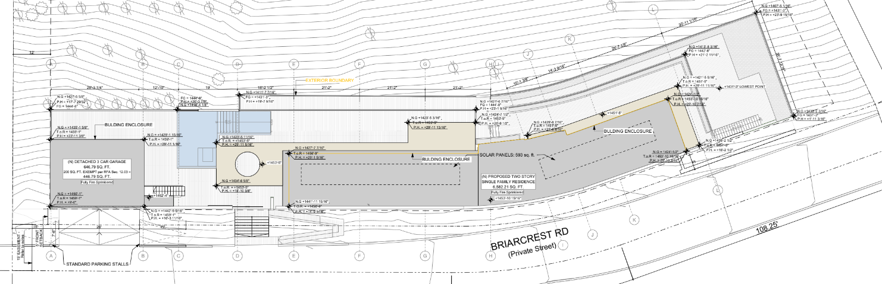
BUILDING HEIGHT

Slide 11
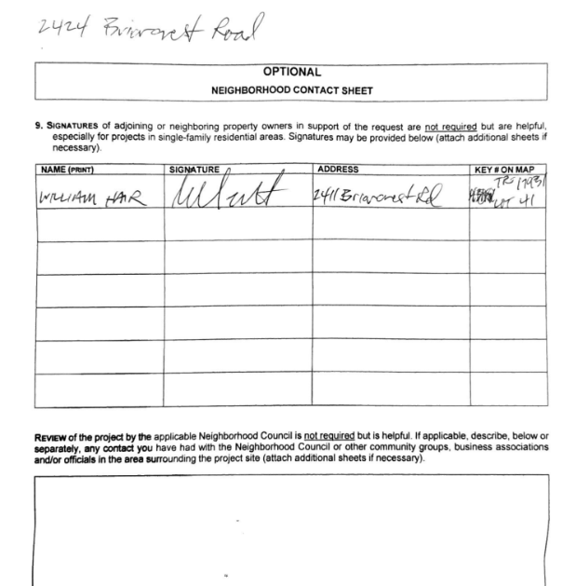
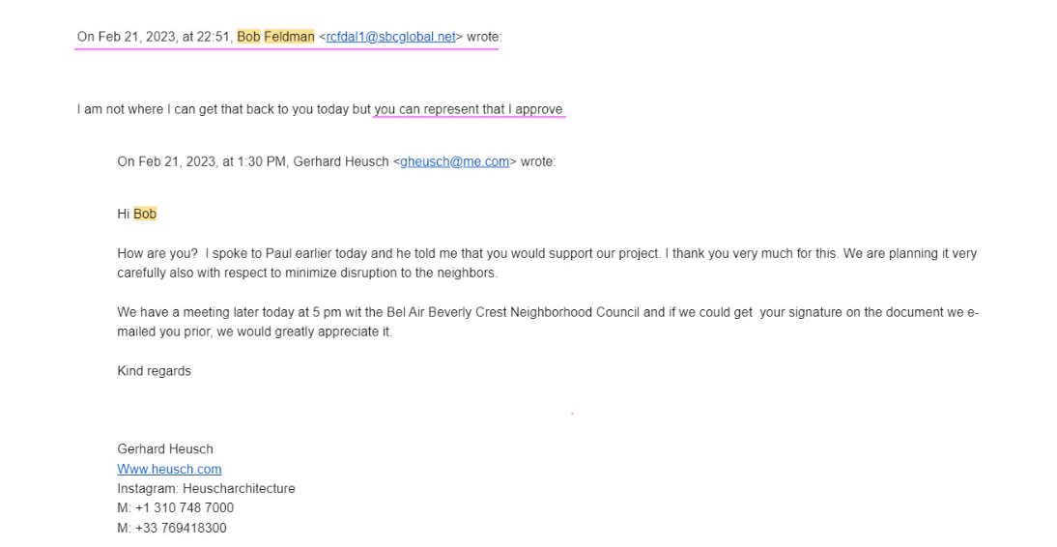
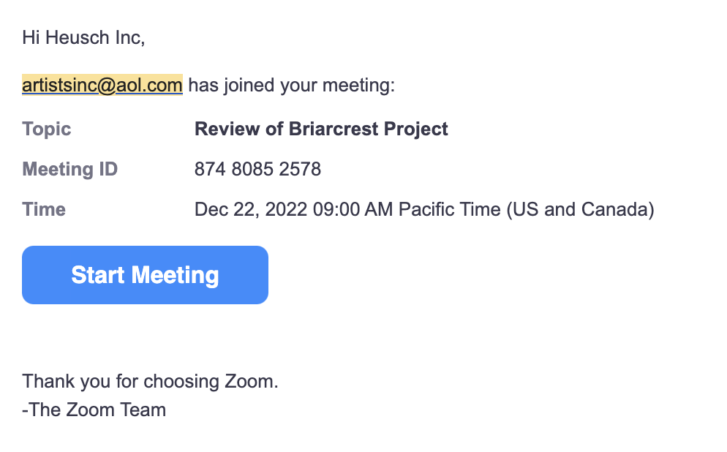
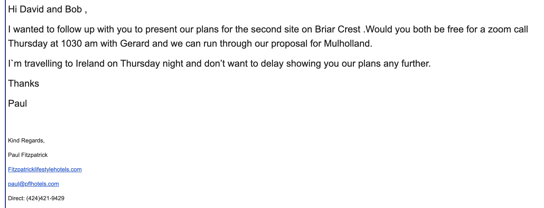
SUPPORT SIGNATURES

Slide 12
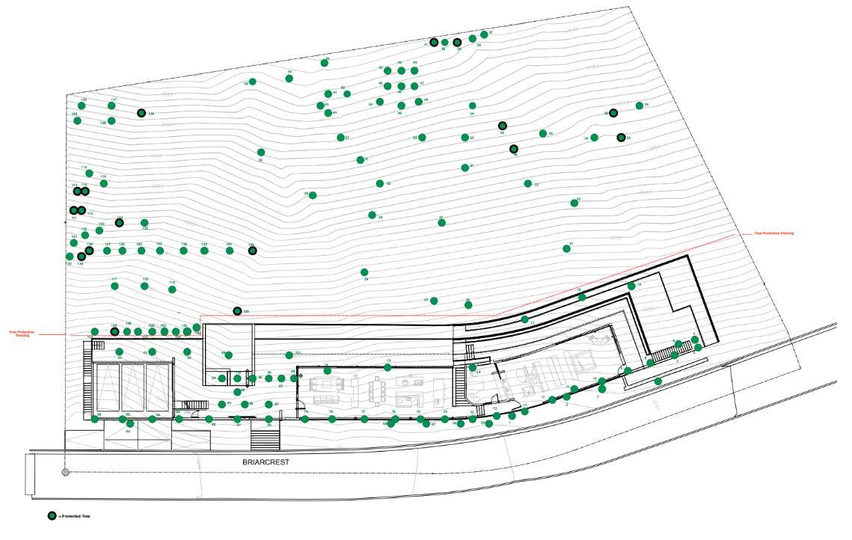
PROTECTED / NON – PROTECTED TREES REMOVED
Landscape - Tree Plan
55 TREES TO BE REMOVED – NONE OF THEM ARE NATIVE NOR PROTECTED
REPLACED WITH NATIVE TREES AT 1:1 RATIO (NOT REQUESTED BY THE CITY)

Slide 13
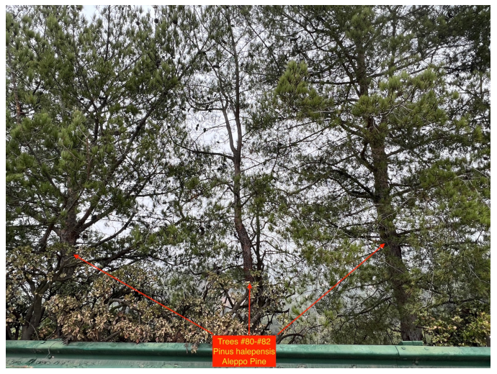
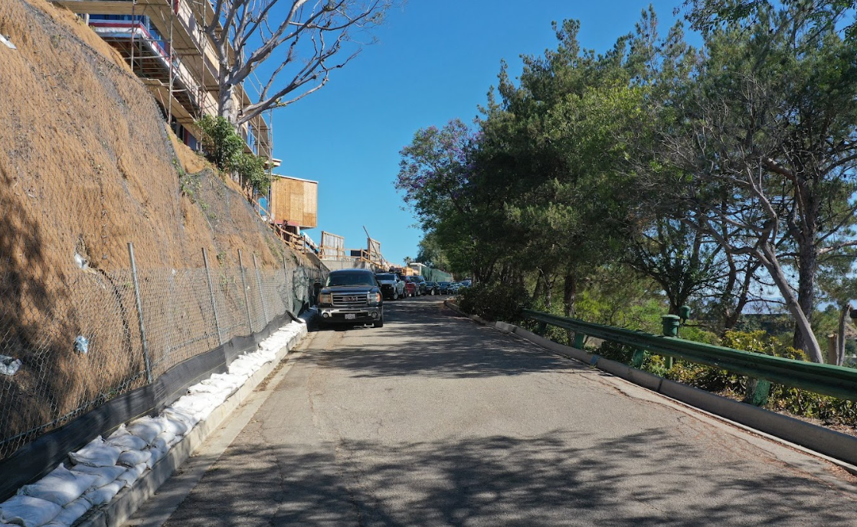
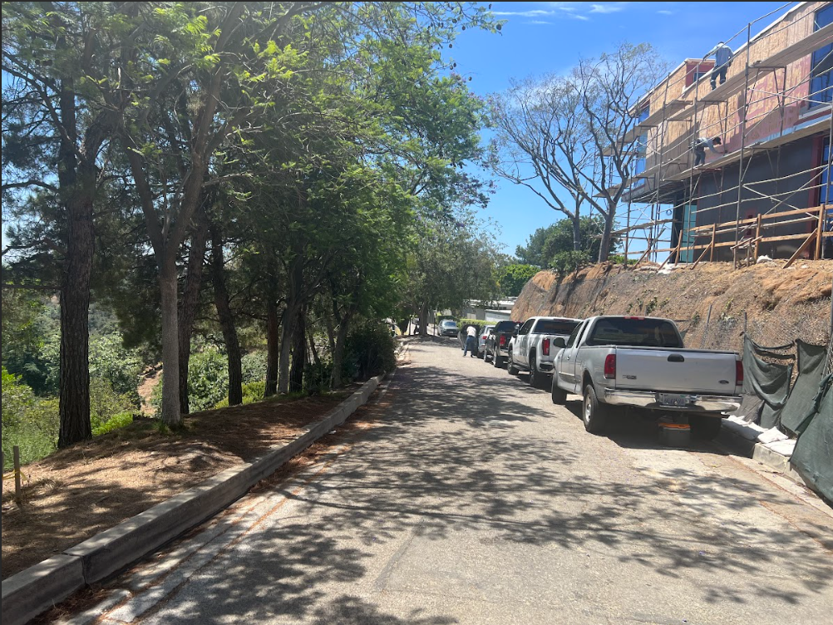
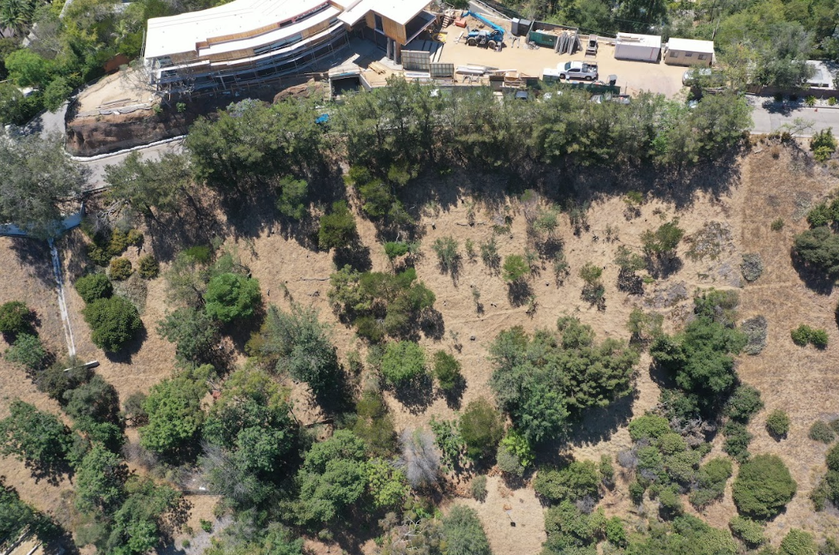
PROTECTED / NON – PROTECTED TREES REMOVED

Slide 14
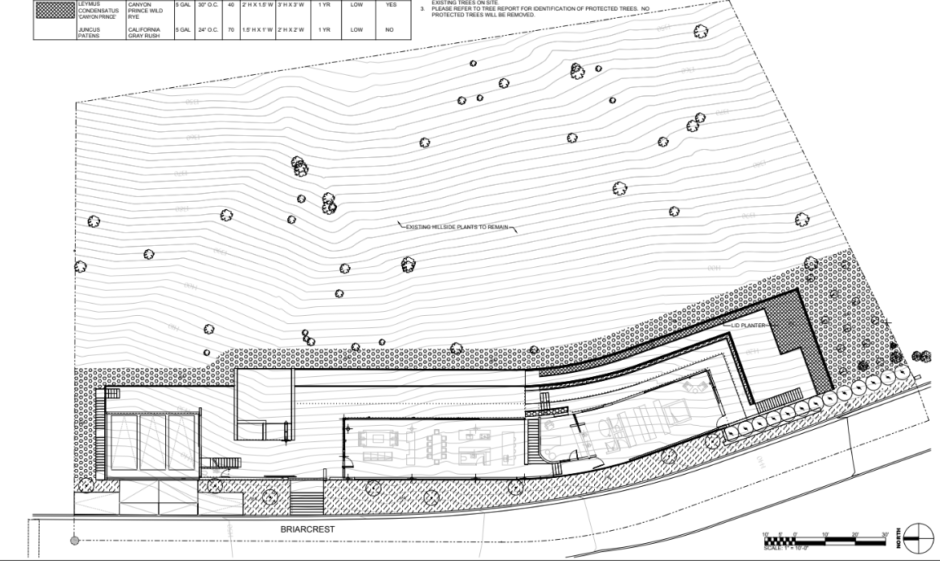
PROTECTED / NON – PROTECTED TREES REMOVED
Landscape – Landscape Plan

Slide 15
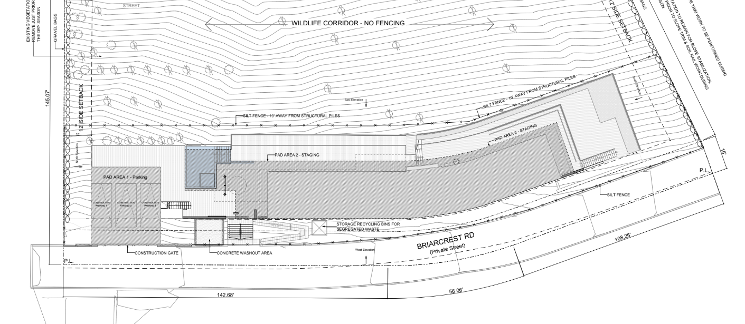
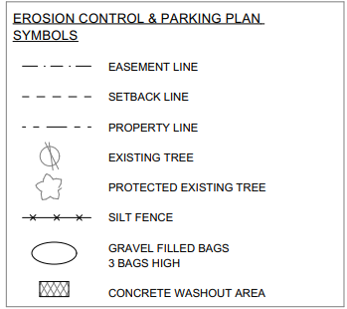
PROPOSED FENCING AND WILDLIFE CORRIDOR
Erosion Control and Parking Plan

Slide 16
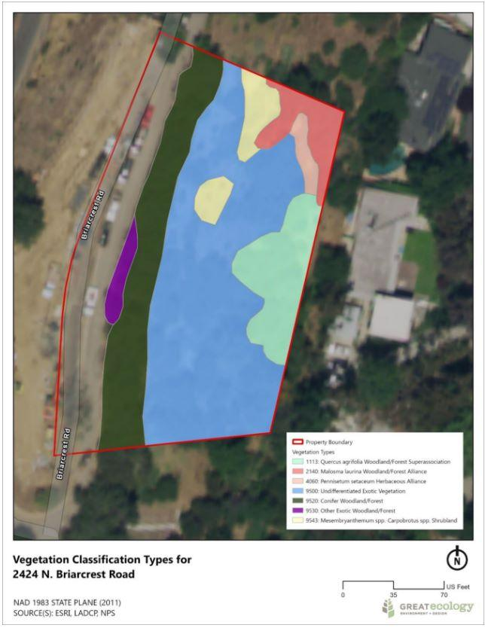
SENSITIVE NATURAL COMMUNITIES
Vegetation Classification Types

Slide 17
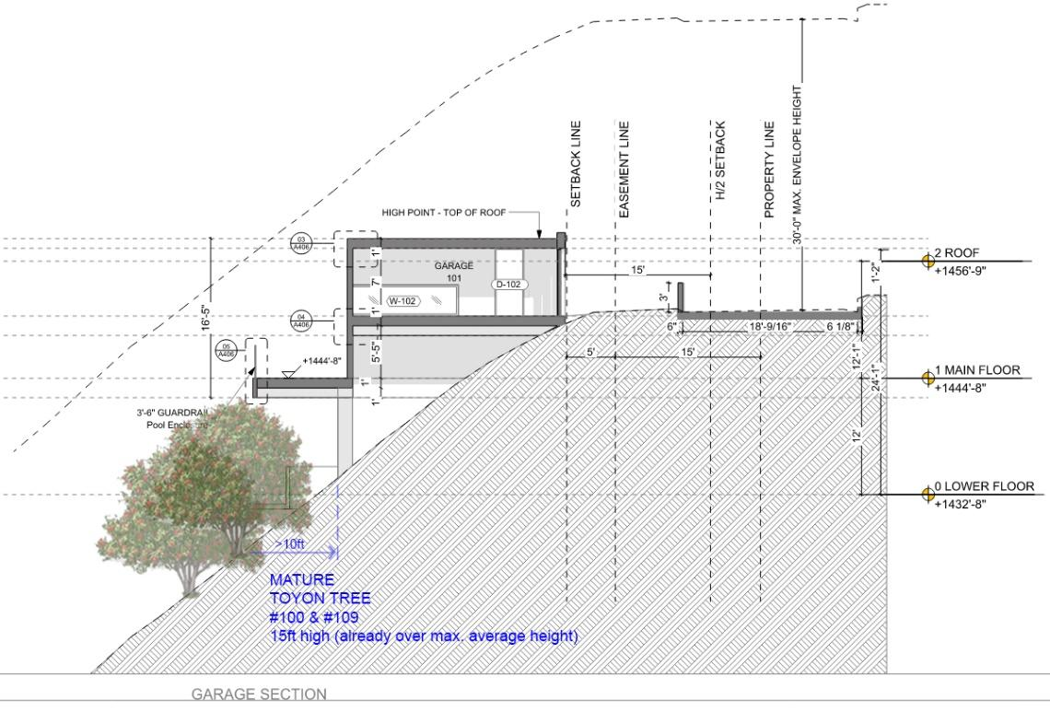
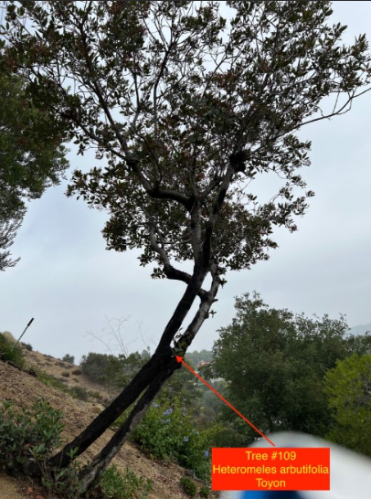
SENSITIVE NATURAL COMMUNITIES
Section above protected trees

Slide 18
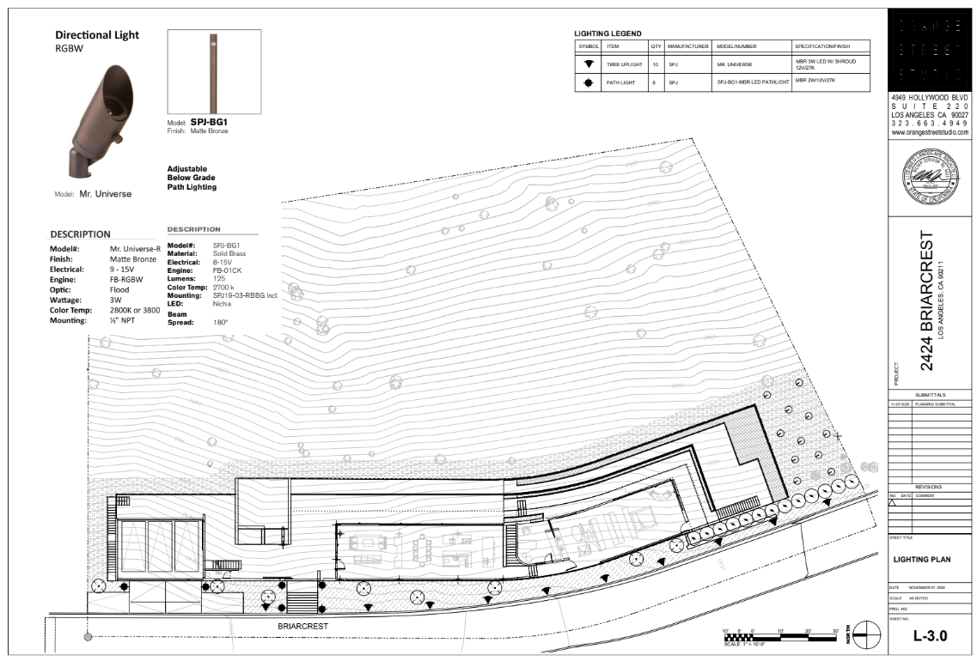
LIGHTING DESIGN
Landscape Lighting Plan
NO LIGHTING FACING DOWN SLOPE

Slide 19
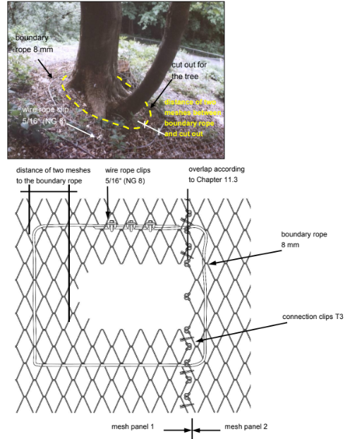
TECCO MESH
Specifications of Tecco Erosion Control Mat

